Slide 1
Cohérence Totale
Track B - Quantum image generation

Slide 2





Image generation

Slide 3
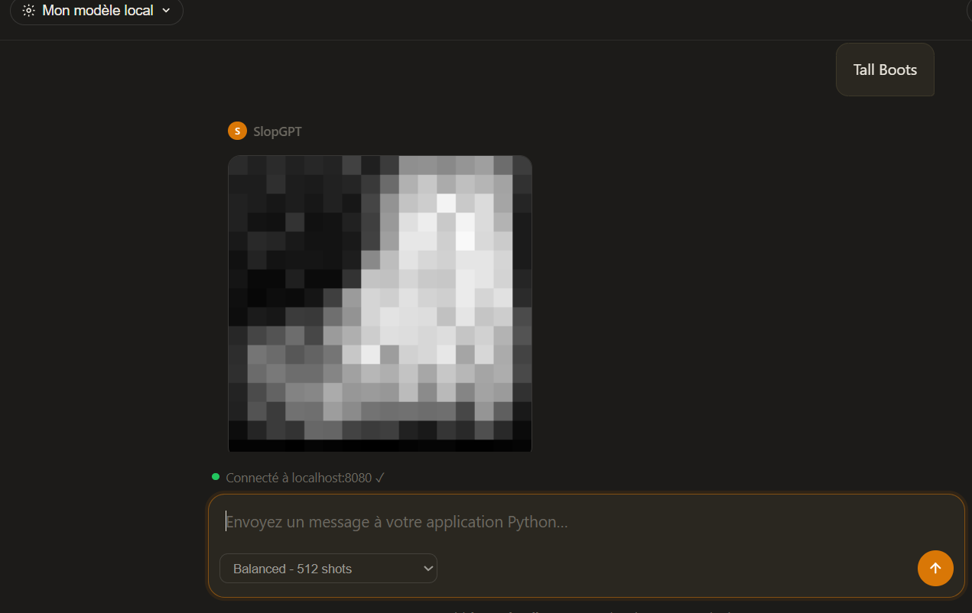
Just like a Classical AI
Does any prompt work? How does it work and what is new? Why such a low resolution?

Slide 4
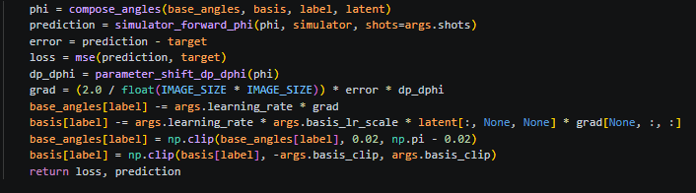
The training algorithm (First model)
Measure qubits → brightness probabilities ↓ Compare generated image with real image ↓ Update angles using SPSA / parameter-shift ↓ Repeat
Fashion-MNIST (dataset) 16x16 image ↓ Convert pixels into RY angles ↓ Run quantum circuit many times

Slide 5
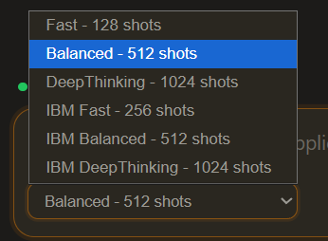
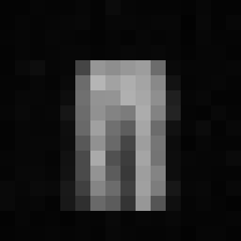
It works on the IBM computer (First model)
We can choose the number of shots.
Here is the result.

Slide 6
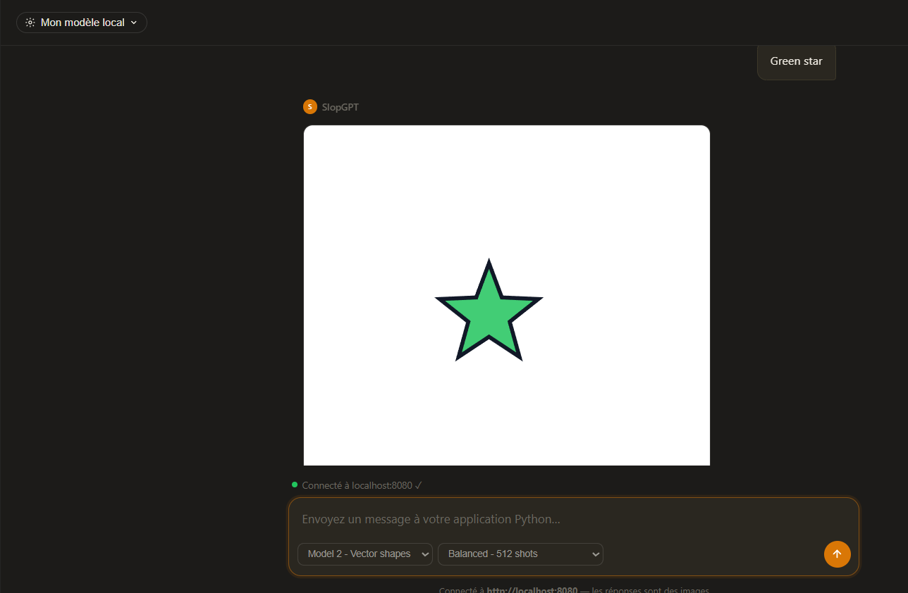
We also tried another way (Vector Graphics)
What it is: Text-to-vector image generator.
The Tech Stack: PennyLane (Quantum) + PyTorch (Classical).
The Goal: Prove quantum parameter efficiency in generative AI.

Slide 7
The training algorithm (Second model)
1. Classical Encode: Maps text prompts (shape/color) to frequencies.
2. Quantum Circuit: A 10-qubit circuit entangles features with injected noise.
3. Measurement: Expectation values (⟨Z⟩) form a classical latent vector.
4. Classical Decode: A lightweight neural network draws the final SVG.

Slide 8
The "Quantum Advantage"
Not about brute speed: Classical hardware is faster at drawing shapes.
Massive State Space: 10 qubits = 210 (1,024-dimensional) complex Hilbert space.
Parameter Efficiency: Replaces massive classical layers with a compact quantum circuit.
Correlated Noise: Quantum entanglement structurally links the generated layout.

Slide 9
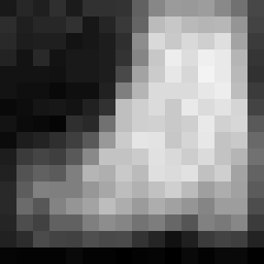
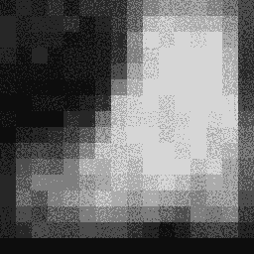
How to make it better?
Upscaling the image.

Slide 10
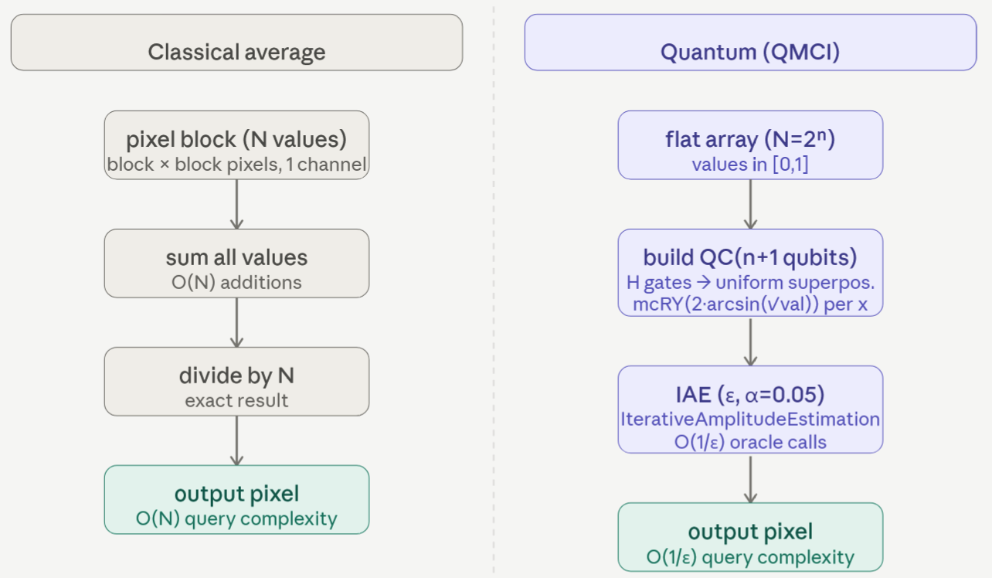
Downscaling

Slide 11
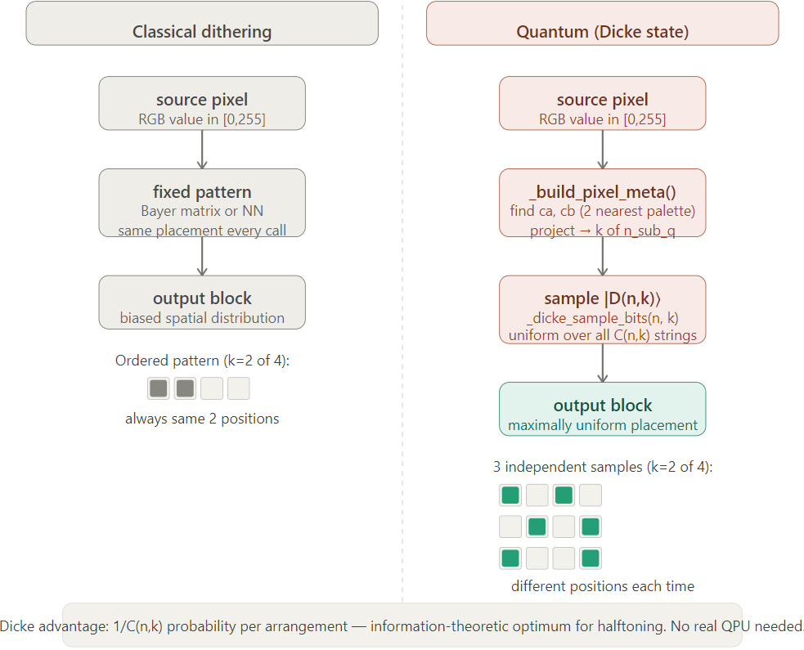
Upscaling

